Slide 1
CHAPTER 1: BEGINNINGS TO 1763
EXPLORATION & THE COLONIAL ERA

Slide 2
THE AMERICAS, WEST AFRICA, AND EUROPE – SECTION 1
Ancient Cultures arrived about 22,000 years ago via a land bridge
Earliest settlers were hunters
Agriculture thrived starting about 5,000 years ago
Some Natives remained Nomadic
Maya, Aztec, and Inca societies flourished

Slide 3
NATIVE AMERICAS IN 1400S
Native American societies in North America were as varied as the geography
The Pueblo (SW) and Iroquois (NE) were two famous tribes
Most of the tribes in America had common religious views, trade patterns & values

Slide 4
WEST AFRICAN SOCIETIES OF THE 1400S
Long established, sophisticated societies existed in Western Africa
The Kingdom of Songhai controlled trans-Sahara trade
Kingdom of Benin and Kongo were two famous dynasties
Village and family bonds formed the basis of life

Slide 5
EUROPEAN SOCIETIES OF THE 1400S
European villages had a long tradition of social hierarchy – complete with nobles, merchants & peasants
Christianity played a critical role – religious leaders had power
The Reformation in the early 1500s led to a split in the church
Martin Luther

Slide 6
EUROPEAN EXPLORATION
The countries of Portugal, Spain, France and England explored in the late 1400s for God, Gold, and Glory
Improved mapmaking, better sailboats, compasses, astrolabes, Prince Henry– all led to better exploration

Slide 7
SPANISH NORTH AMERICA – SECTION 2
Columbus crosses the Atlantic in October of 1492 and lands in San Salvador (“Holy Savior”)
He spent about 3 months exploring Islands in the Bahamas
Europeans used advanced weapons to force locals into labor: Plantation System
Disease devastated Native population

Slide 8
IMPACT OF COLUMBUS
On Africans- Before slave trade ended in the 1800s, 10 million Africans taken
On Europeans- Biggest voluntary migration in world history
On Trade- Columbian Exchange meant new goods & products flowed between continents

Slide 9
The Columbian Biological Exchange
 | Old World to New World: | New World to Old World:
Diseases: | Smallpox Measles Chicken Pox Malaria Yellow Fever Influenza The Common Cold | Syphilis
| This page was last updated on 12/3/98. | Return to History 111 Supplements

Slide 10
The Columbian Biological Exchange
 | Old World to New World: | New World to Old World:
Animals: | Horses Cattle Pigs Sheep Goats Chickens | Turkeys Llamas Alpacas Guinea Pigs

Slide 11
The Columbian Biological Exchange
 | Old World to New World: | New World to Old World:
Plants: | Rice Wheat Barley Oats Coffee Sugarcane Bananas Melons Olives Dandelions Daisies Clover Ragweed Kentucky Bluegrass | Corn (Maize) Potatoes (White & Sweet Varieties) Beans (Snap, Kidney, & Lima Varieties) Tobacco Peanuts Squash Peppers Tomatoes Pumpkins Pineapples Cacao (Source of Chocolate) Chicle (Source of Chewing Gum) Papayas Manioc (Tapioca) Guavas Avocados

Slide 12
SPAIN CLAIMS A NEW EMPIRE
Spanish explorers (Conquistadors) seized much of the Americas
Cortes conquered the Aztecs in Mexico
Pizzaro conquered the Incas in Peru
Exploitation of local populations was significant – Encomienda System

Slide 13
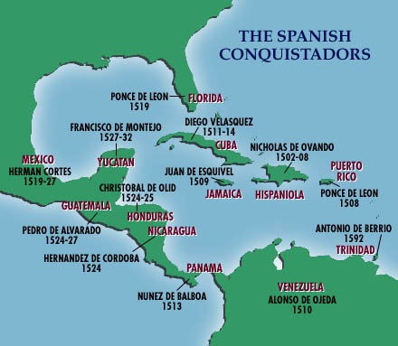

Slide 14
SPAIN EXPLORES SOUTHWEST AND WESTERN AMERICA
Mid-1500s, Spain explored much of what is today the SW & West of the USA
New Mexico settled by Spanish priest who converted Natives (Pueblos)
Texas area had 30 expeditions in 16th century
California was site of numerous missions
California Missions

Slide 15
EARLY BRITISH COLONIES – SECTION 3
Beginning in the early 1600s, the English established colonies along the eastern coast of North America
1607: Jamestown was first to be settled
John Smith led this group of settlers
Colony struggled at first, then was saved by Tobacco crop

Slide 16
PURITANS CREATE A “NEW ENGLAND”
The 16th century Reformation caused a split in the Christian Church; Catholics and Protestants
One extreme group of Protestant reformers – the Puritans sought to cleanse or “purify” their religion of all traces of Catholicism
PURITAN, OR “PILGRIM”

Slide 17
COLONISTS MEET RESISTANCE
New England Colonists (Puritans) soon conflicted with the Native Americans over land & religion
King Philip’s War was fought in 1675 between the Natives and Puritans ending a year later with many dead and the Natives retreating

Slide 18
SETTLING THE MIDDLE COLONIES
Dominated by Dutch and Quaker settlers, the Middle Colonies were founded in the mid-1600s
William Penn led Quakers as they colonized Pennsylvania and Delaware

Slide 19
ENGLAND’S COLONIES PROSPER
Throughout the 1600s and 1700s, more British Colonies were established
By 1752, the English Crown had assumed more & more responsibility for the 13 colonies
Mercantilism & Navigation Acts were two such ways that the English government controlled the colonies
King George III

Slide 20
MERCANTILISM: AN ECONOMIC SYSTEM IN WHICH NATIONS SEEK TO INCREASE THEIR WEALTH BY OBTAINING GOLD & SILVER AND WITH A FAVORABLE BALANCE OF TRADE
MERCANTILISM

Slide 21
NAVIGATION ACTS
1651- England’s Parliament passed a series of laws known as the Navigation Acts
These laws restricted the colonies shipping & trade
Ships, destinations, crews, goods: All strictly regulated by the English
The colonies were developing a spirit of self-determination. Therefore, they were NOT happy with these restrictions

Slide 22
THE COLONIES COME OF AGE – SECTION 4
New England, Middle Colonies, and the South – all developed distinct economies and societies
In the South, rural Plantations with a single cash crop were common
Small Southern farmers (Germans, Scots, Irish) and African slaves made up the majority of people
Southern Plantation

Slide 23
THE MIDDLE PASSAGE
During the 17th century, Africans endured a transatlantic crossing from Africa to the North American Colonies
Cruelty characterized the months long journey – 13% died on route

Slide 24
AFRICANS MAINTAIN PARTS OF THEIR CULTURE
Despite enslavement, Africans coped with the horrors of slavery via music, dance, and storytelling
Slaves also resisted their position of subservience by faking illness, breaking tools, or work slowdowns
Others were more radical and tried escape & revolt

Slide 25
NORTHERN COLONIES COMMERCE THRIVES
The development of cities, expansion of trade, and diverse economies gradually made the North radically different from the South
Philly was the 2nd largest British port
Farming differed from the South: smaller, more diverse crops in North
LIBERTY BELL

Slide 26
THE ENLIGHTENMENT AND THE GREAT AWAKENING
1700s: An intellectual movement known as the Enlightenment began in Europe and a religious movement known as the Great Awakening started in the Colonies
The Enlightenment emphasized reason, science, and observation and led to the discovery of natural laws
Copernicus, Galileo, Franklin and Newton were key figures

Slide 27
RELIGIOUS REVIVAL: THE GREAT AWAKENING
A series of religious revivals aimed at restoring devotion & piety swept through the colonies in the mid-1700s
Jonathan Edwards was a Puritan priest from New England who was instrumental in the movement
Fire & Brimstone style of worship; large, emotionally charged crowds
Like the Enlightenment the movement stressed the importance of the individual

Slide 28
FRENCH AND INDIAN WAR
Competition in North America led to a war (1754-1763) between old rivals France and England
The French in North America were tradesmen (furs) not long-term inhabitants
Ohio River valley was the site of the conflict
The Colonists supported the British while the Natives supported the French
FRENCH INDIAN WAR BY NAT YOUNGBLOOD

Slide 29
BRITAIN DEFEATS AN OLD ENEMY
While the French had early victories, the British led by William Pitt and George Washington eventually defeated the French
Treaty of Paris ends the war in 1763
Brits claim most of North America including Florida (from French ally Spain) & Canada
Native Americans also realized a French loss was a Native American loss
WILLIAM PITT ON A COIN

Slide 30
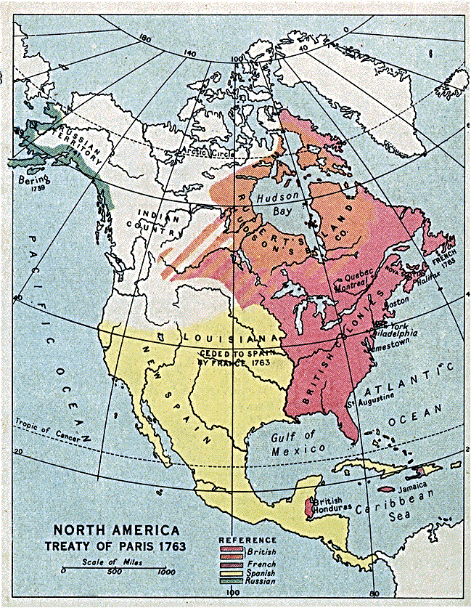

Slide 31
PROCLAMATION LINE OF 1763
To avoid further costly conflicts with Native Americans, the British government prohibited colonists from settling west of the Appalachian Mountains
The Proclamation established a line along the Appalachian that colonists could not cross (They did anyway)

